Slide 1

Student and Subject Management Module
In Drupal

Slide 2

Associates
Thalla Saivivek
Sailesh

Slide 3

Introduction
Our Student and Subject Management module is a powerful tool designed to streamline the process of managing student records and subject information within your Drupal-based platform. With this module, educational institutions and organizations can efficiently handle student details and associated subjects, enhancing administrative efficiency and data accuracy.

Slide 4
Features:
Student Record Management: Easily capture and organize essential student information, such as Student ID, Name, Subject ID, Email, and Phone, in a centralized database.
Subject Information: Seamlessly manage subjects by recording Subject ID, Name, and Department, creating a comprehensive overview of the curriculum.
User-Friendly Interface: Our module features an intuitive user interface that simplifies adding, editing, and deleting student records and subject details.
Efficient Editing: Edit existing student records and update information like Student Name, Subject ID, Email, and Phone effortlessly through the Edit Student Form.
Structured Listings: The module generates organized listings of students, allowing users to quickly view essential information at a glance.
Smart Deletion: Enable secure deletion of student records with built-in confirmation steps, ensuring data integrity.
Subject-Student Relationship: Establish a connection between students and subjects using the Subject ID, facilitating efficient tracking of enrolled subjects.

Slide 5
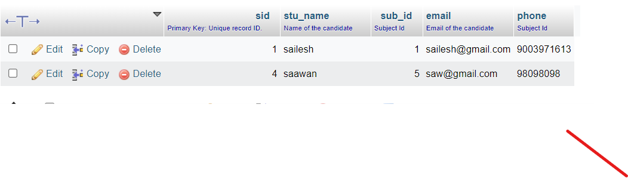
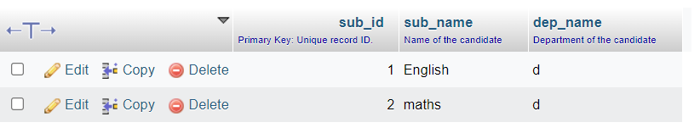
Data Structure
STUDENT TABLE
Student ID
Student Name
Subject ID
Email
Phone
SUBJECT TABLE
Subject ID
Name
Department

Slide 6
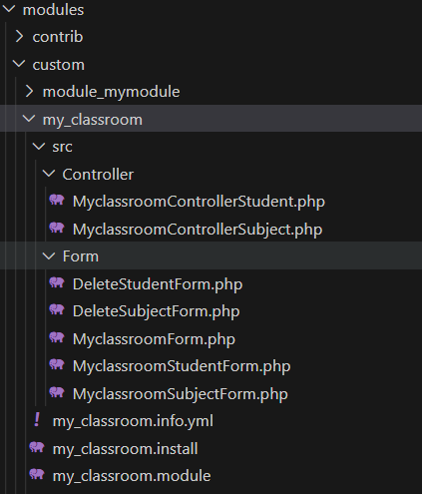
Folder Structure
Myclass room is the custom module name under the folder we have created the separate controller and form functions .

Slide 7
Benefits:
Enhanced Management: Bid farewell to manual record-keeping. Our module simplifies the management of student and subject data, saving time and reducing errors.
Easy Updates: Effortlessly update student information, whether it's a change of contact details or subject enrollment.
Quick Reference: With well-organized listings, users can quickly find student records and access pertinent details.
Seamless Navigation: Navigate effortlessly between the listing page, add student form, and edit student form for a cohesive user experience.
Data Integrity: The module's structure ensures student records and subject details remain accurate and consistent.
Efficient Subject Tracking: Connect students to the subjects they're enrolled in, creating a clear picture of their academic journey.

Slide 8
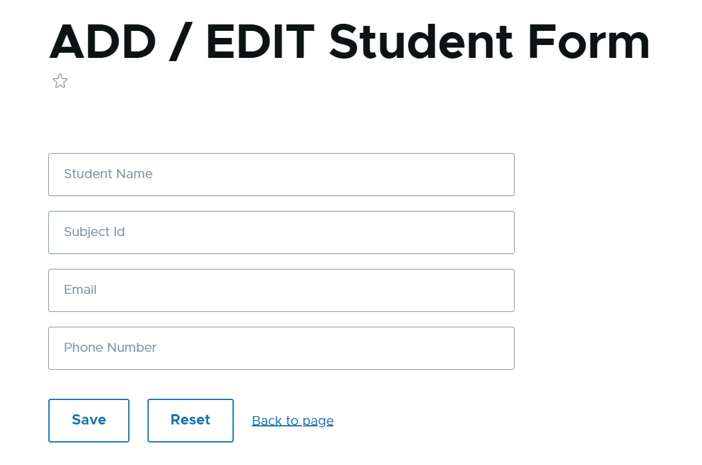
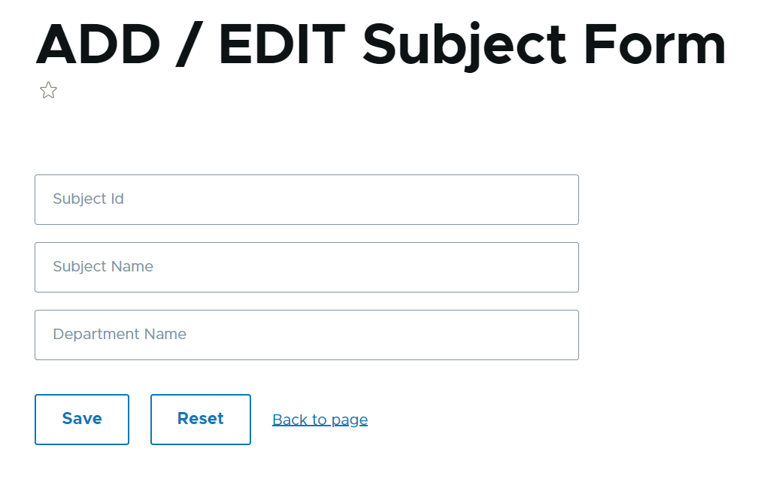
Front Page
Student Page Subject Page

Slide 9
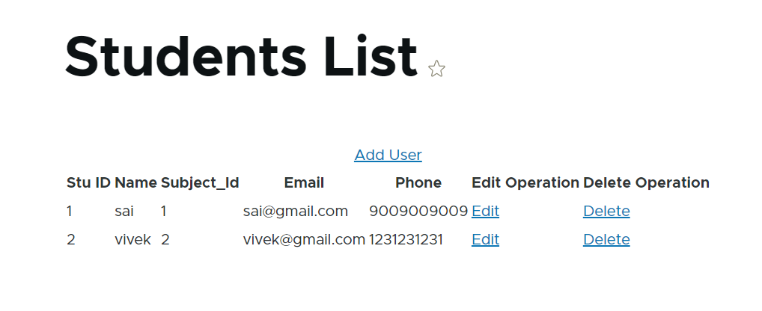
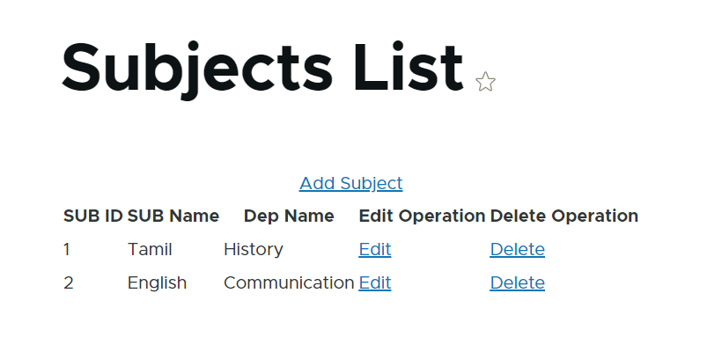

Slide 10
ADD & EDIT

Slide 11
THANK YOU

